Slide 1

BDAT 1004 Data Programming
Final Group Project
Group 4
Bhavya Rastogi, Parbhjoyt Singh &
Shubham Chawla

Slide 2

Content
Project Summary
About our Team
Data Source – API
Project Scope
Tools Used
Database Choice for Storage/Retrieval - MongoDB
Website development– Flask
Data Visualization
Website Deployment – Heroku
Fit Gap Analysis
Mongo DB Realm
Postman

Slide 3

Project Summary
Acquired data from a remote source – API for currency exchange rates.
Python was used for retrieving the data and storing it into a cloud based database – MongoDB
A pseudo-batch process was written in Python that runs every 24 hours to update the database.
Developed a web application using Flask Framework.
Used chart.js library in Javascript to display visualizations such as bar charts and line charts.
Conducted a Fit-Gap Analysis to find out what more could be done in the future.
Built an API using MongoDB Realm that serves data from MongoDB.
Tested our API using Postman

Slide 4




Team Members
Shubham Chawla – Developer
Bachelors in Computer Science, with experience in data mining, analysis and visualization.
Bhavya Rastogi – Business Analyst/ Project Manager
Bachelors in Mathematics with experience in data analysis and project management.
Parbhjoyt Singh – Developer
Bachelors in Computer Science, with experience as associate system engineer.

Slide 5

Project Topic
A client has asked you to build a proof of concept "Web" application to demonstrate your abilities as a team/company. They are prepared to contract your team for several years however, they have many other bids to review.
Our web application will convey our abilities as a team and explain why
we are right for this job.

Slide 6

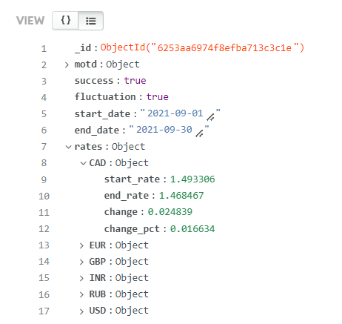
Data Source - API
Our data source is an API for exchange rates.
The base currency was changed from ‘Euro’ to ‘USD’.
We can see the API contains information about dates with changes in value of currencies.
One of many documents
stored in MongoDB

Slide 7

Project Scope
Data Source
Data was extracted from https://api.exchangerate.host/fluctuation?start_date=<value>&end_date=<value>&base=USD
Mongo DB
Website
Use Python to acquire data and store into MongoDB
Built a website using Flask Framework.
MongoDB Realm
Visualization
Built an API that serves data from the live cloud database
Created few line charts and a bar chart using Chart.js library and deployed it to Heroku.

Slide 8

Tools Used
Python
Flask framework
Pymongo module
Chart.js
MongoDB Atlas
MongoDB Realm
Heroku
Visual Studio Code
Postman

Slide 9

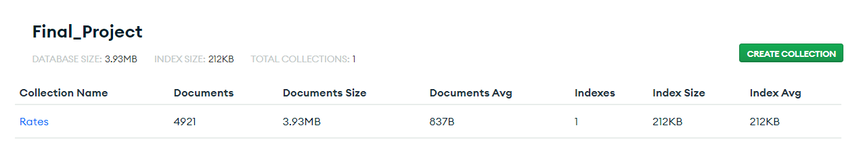
Database – Mongo DB
Created a database –'Final_Project’
with a collection –'Rates'

Slide 10
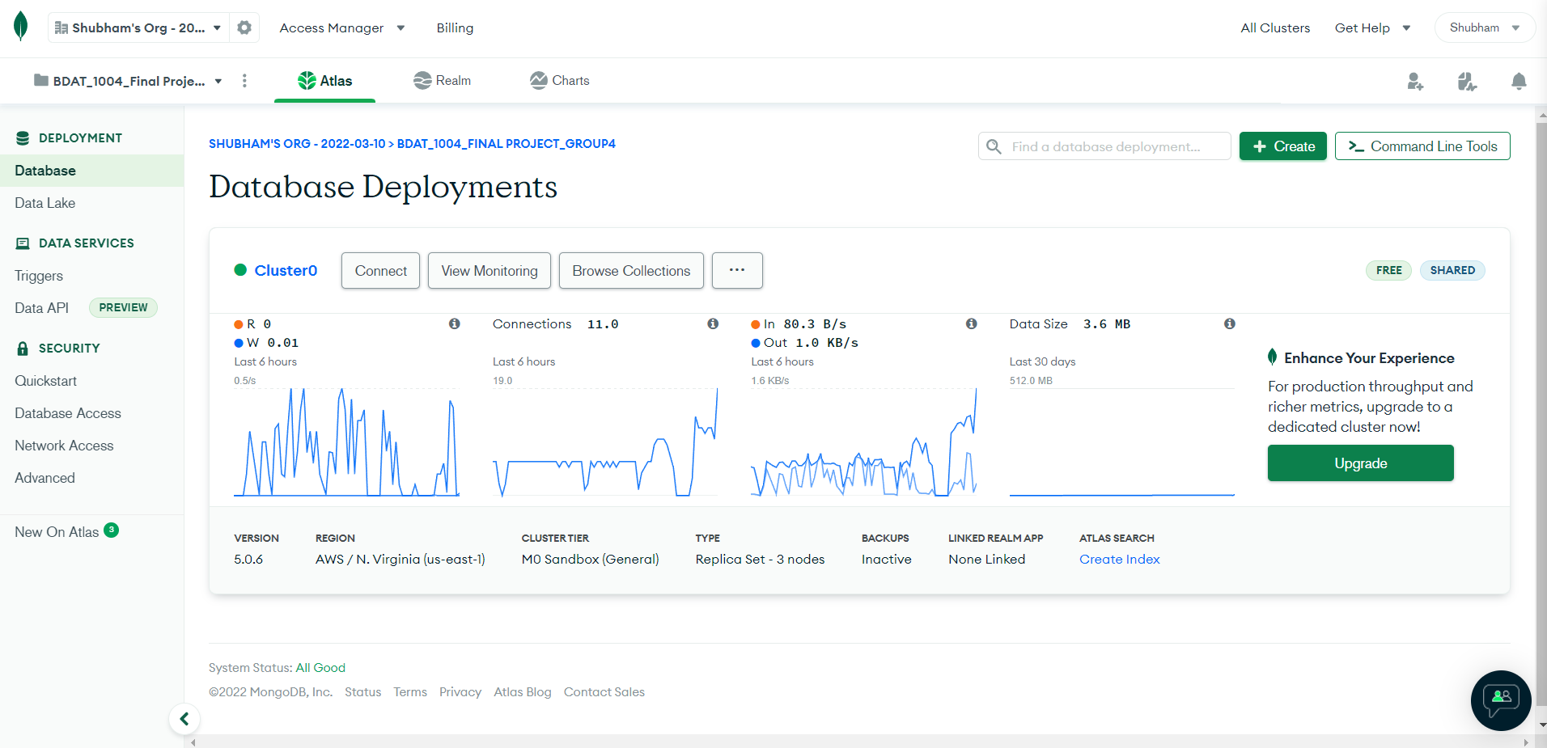
Database – Mongo DB Atlas Dashboard

Slide 11
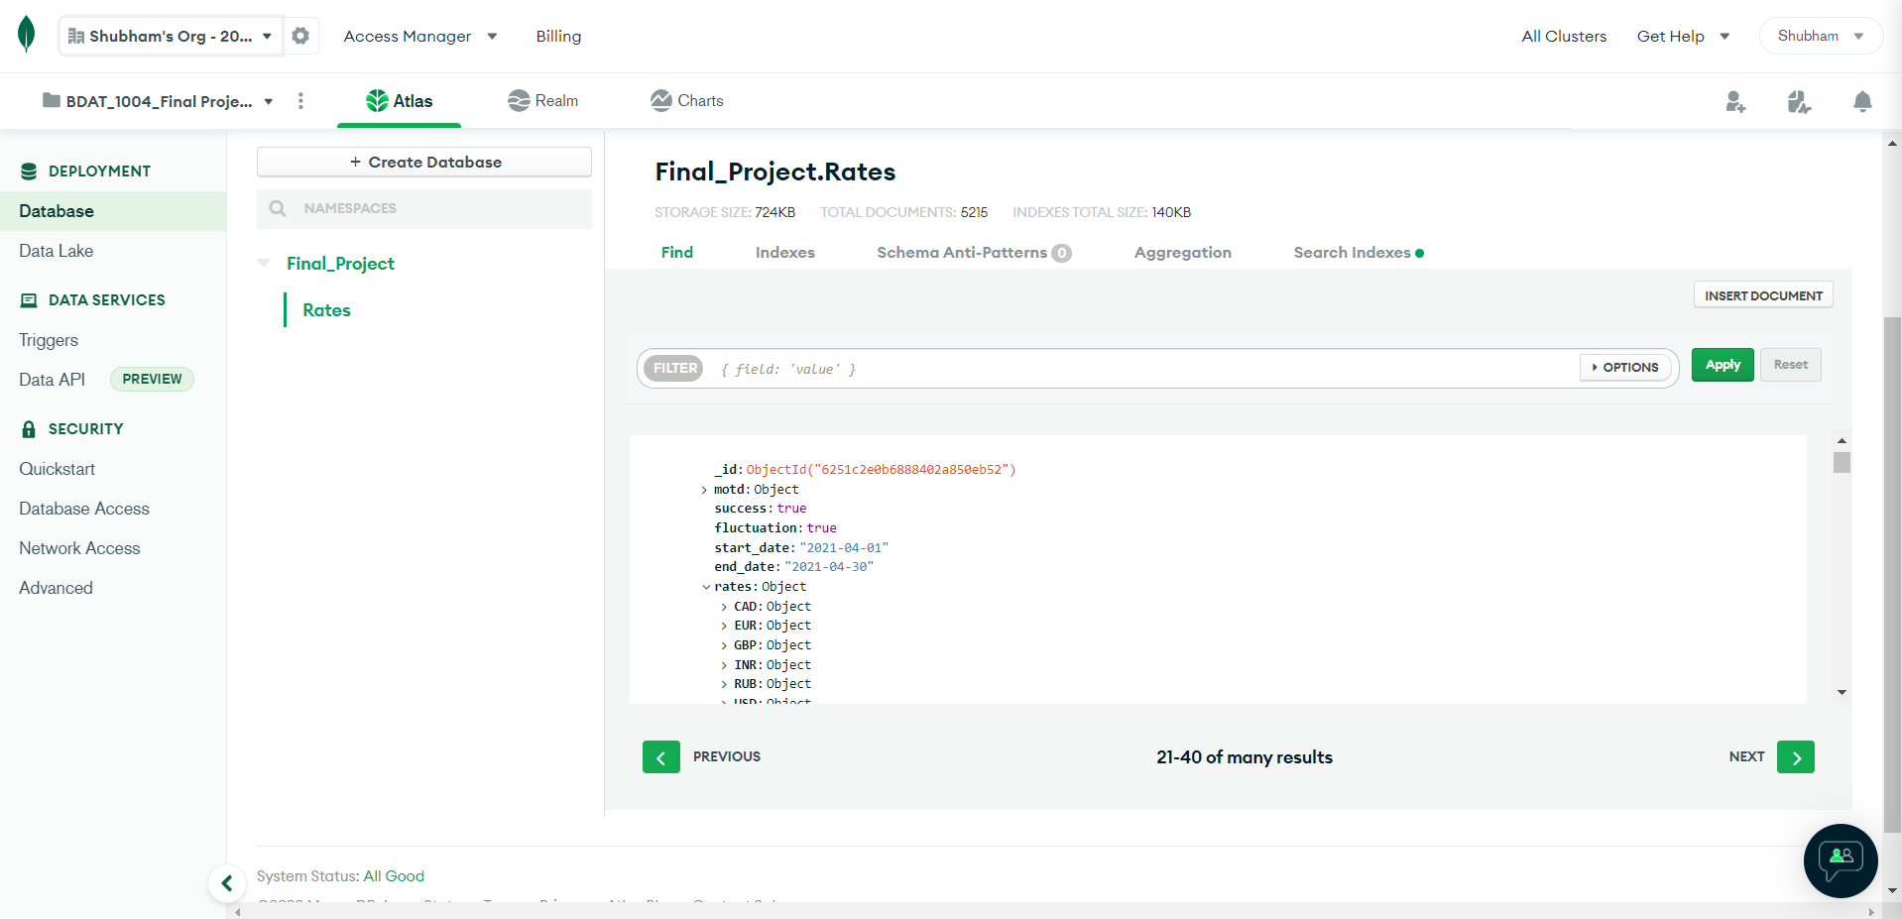
Collection View – Mongo DB

Slide 12

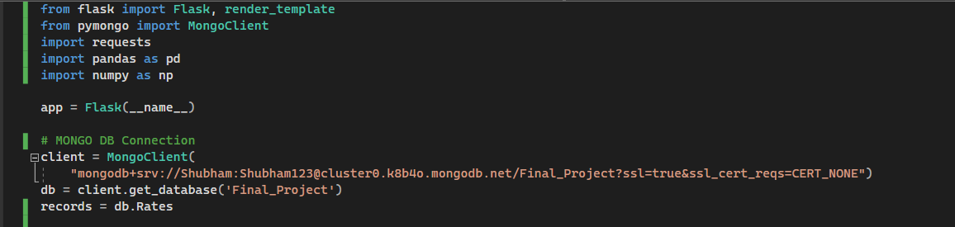
Pymongo Code

Slide 13

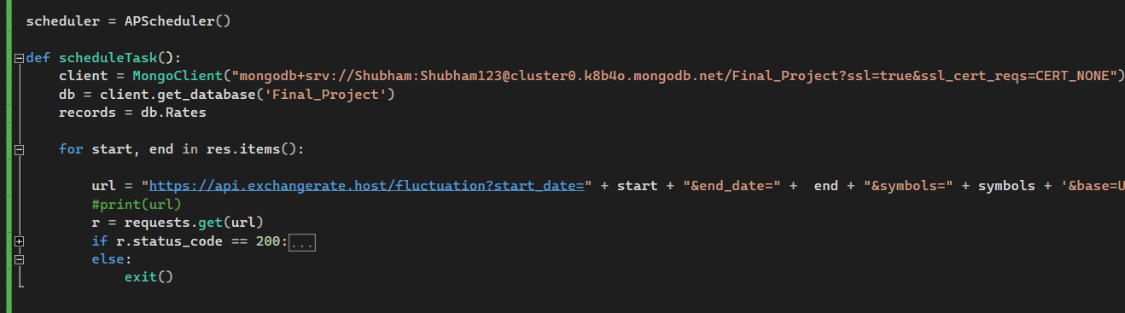
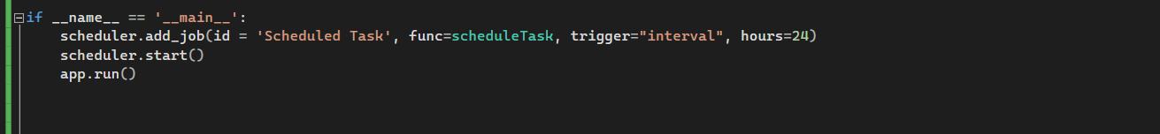
Pseudo Batch Process to acquire data and store it in MongoDB every 24 hours

Slide 14


Website Design – Flask
Our website was created using Flask Framework.
We used HTML, CSS and JS for creating our web structure and used Chart.js library for creating insightful visualizations.

Slide 15

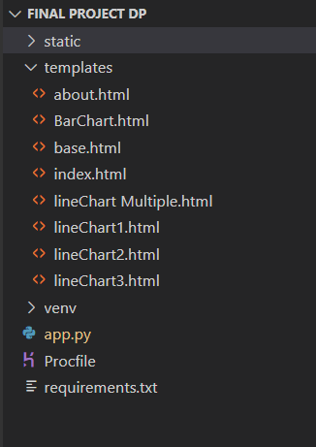
Website Design

Slide 16

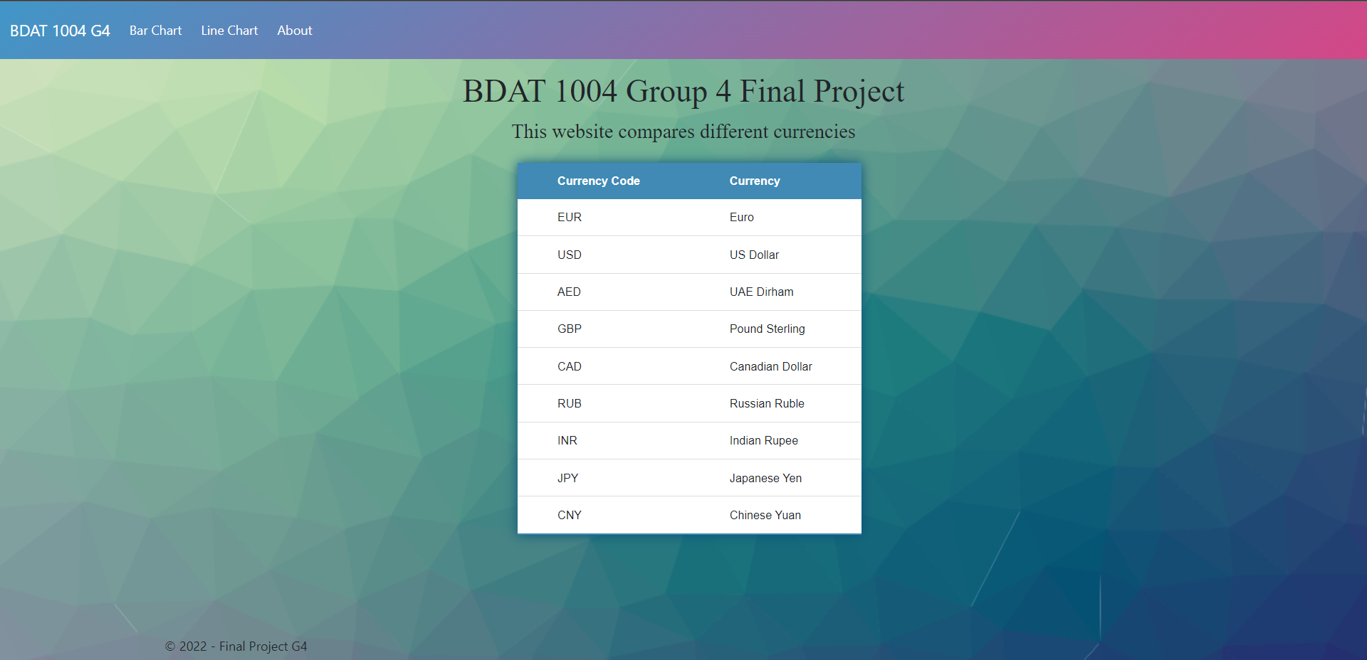
Website Design – Home Page

Slide 17
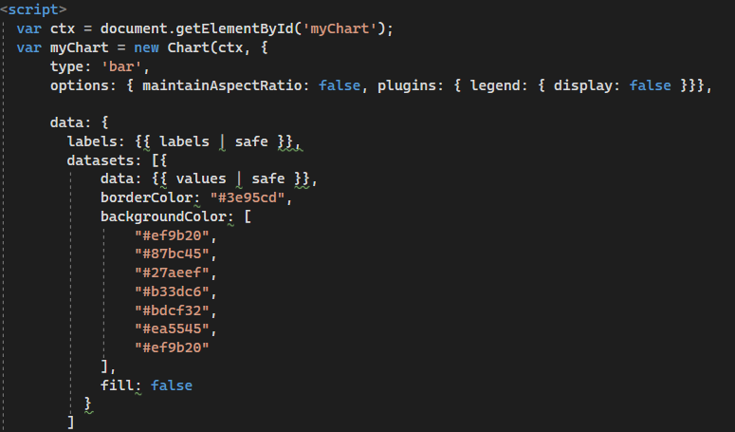
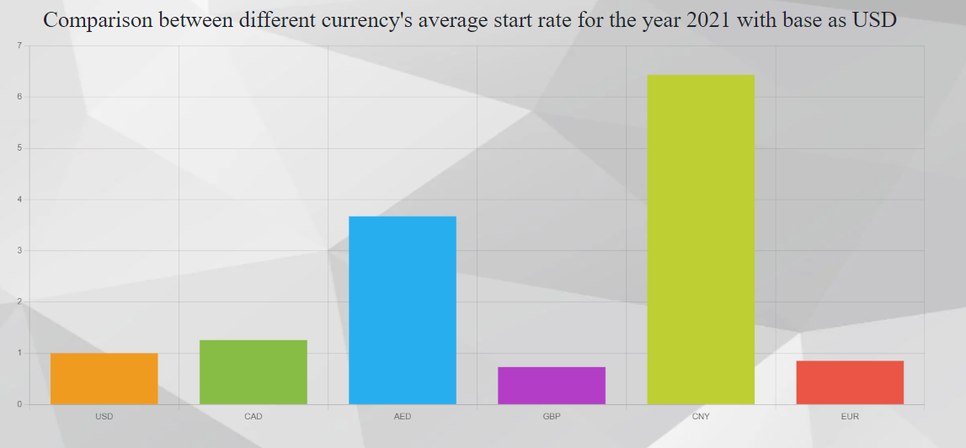
Website Design – Bar Chart

Slide 18

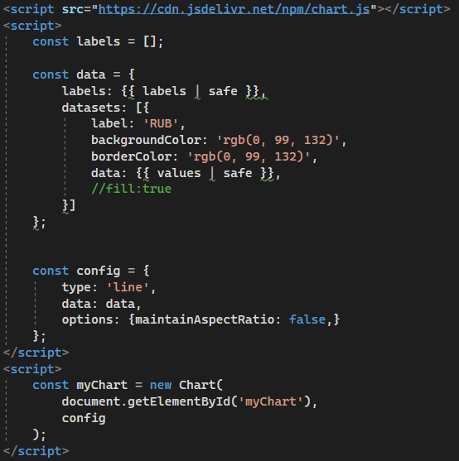
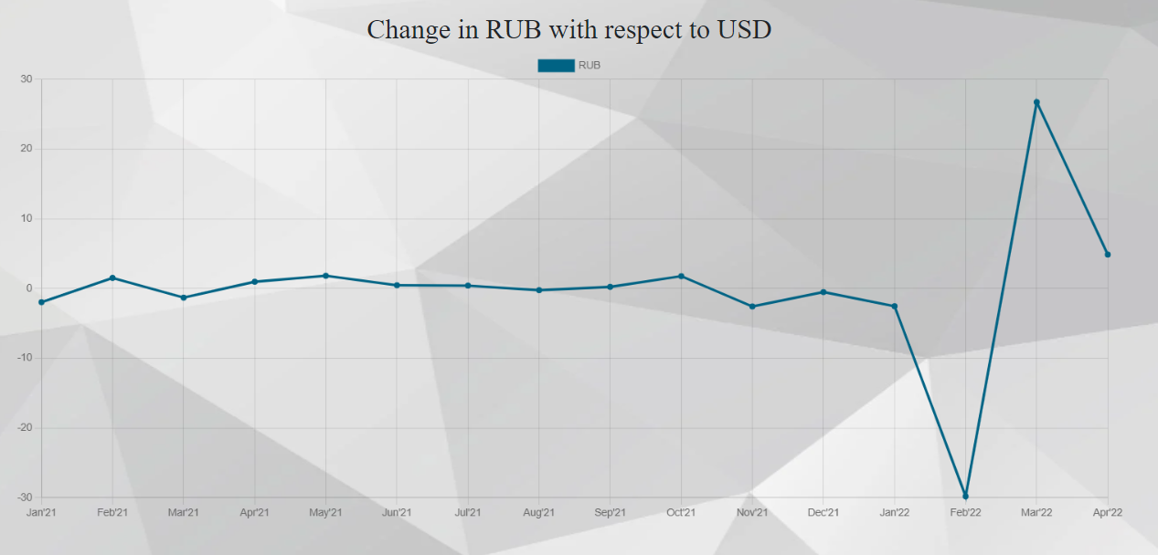
An unusual decrement can be seen during February 2022.
Reason: Unprecedented sanctions on Russia
Website Design – Line Chart (Ruble vs Us Dollar)

Slide 19
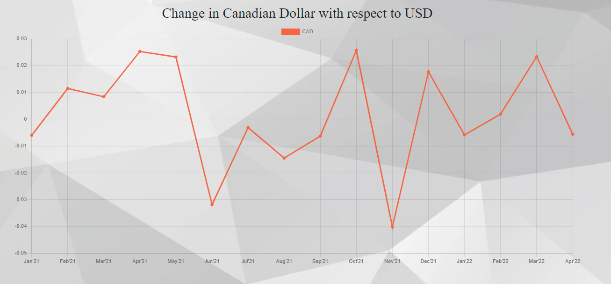
Website Design – Line Chart (CAD vs US Dollar)
This value updates every 24 hours.

Slide 20
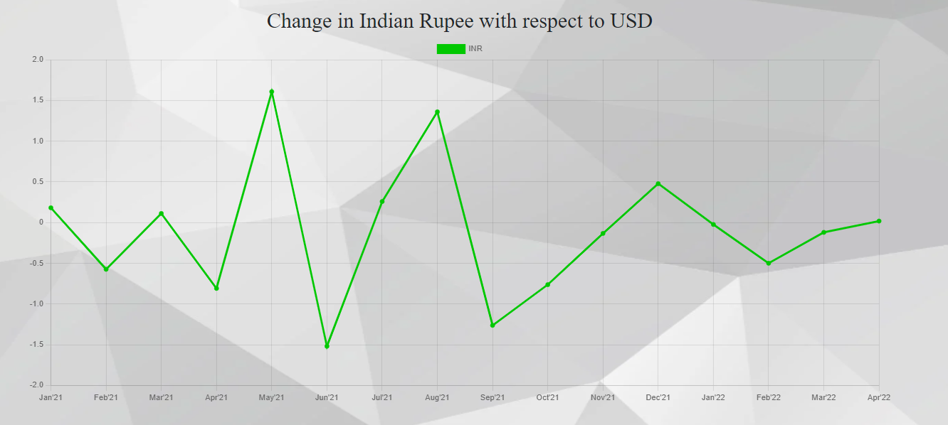
Website Design – Line Chart (INR vs US Dollar)

Slide 21
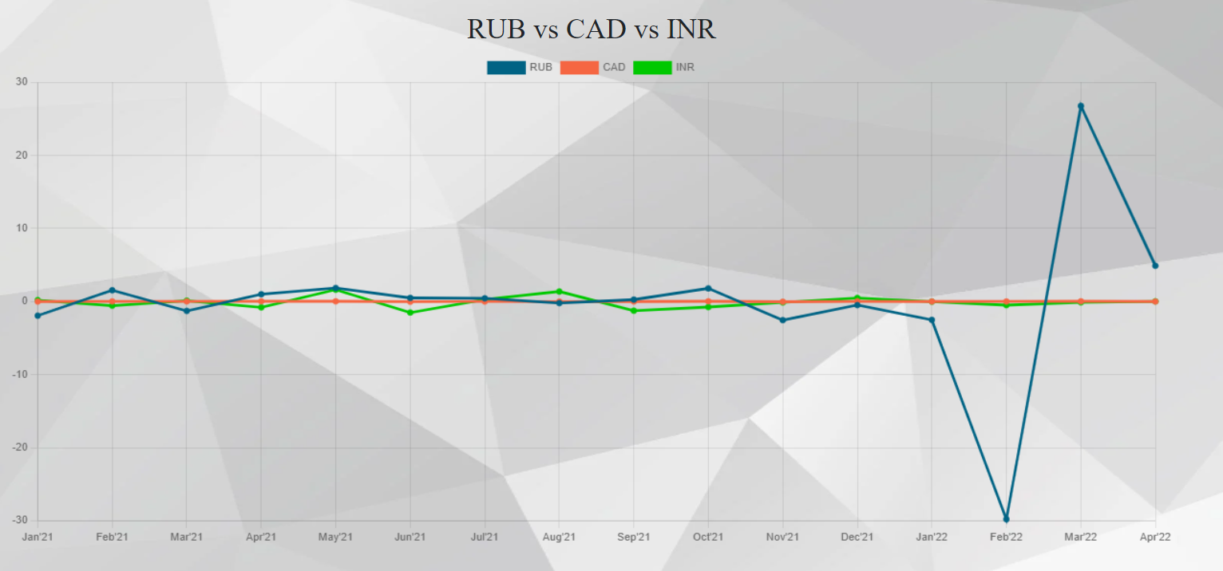
Website Design – Line Chart (RUB vs CAD vs INR)

Slide 22
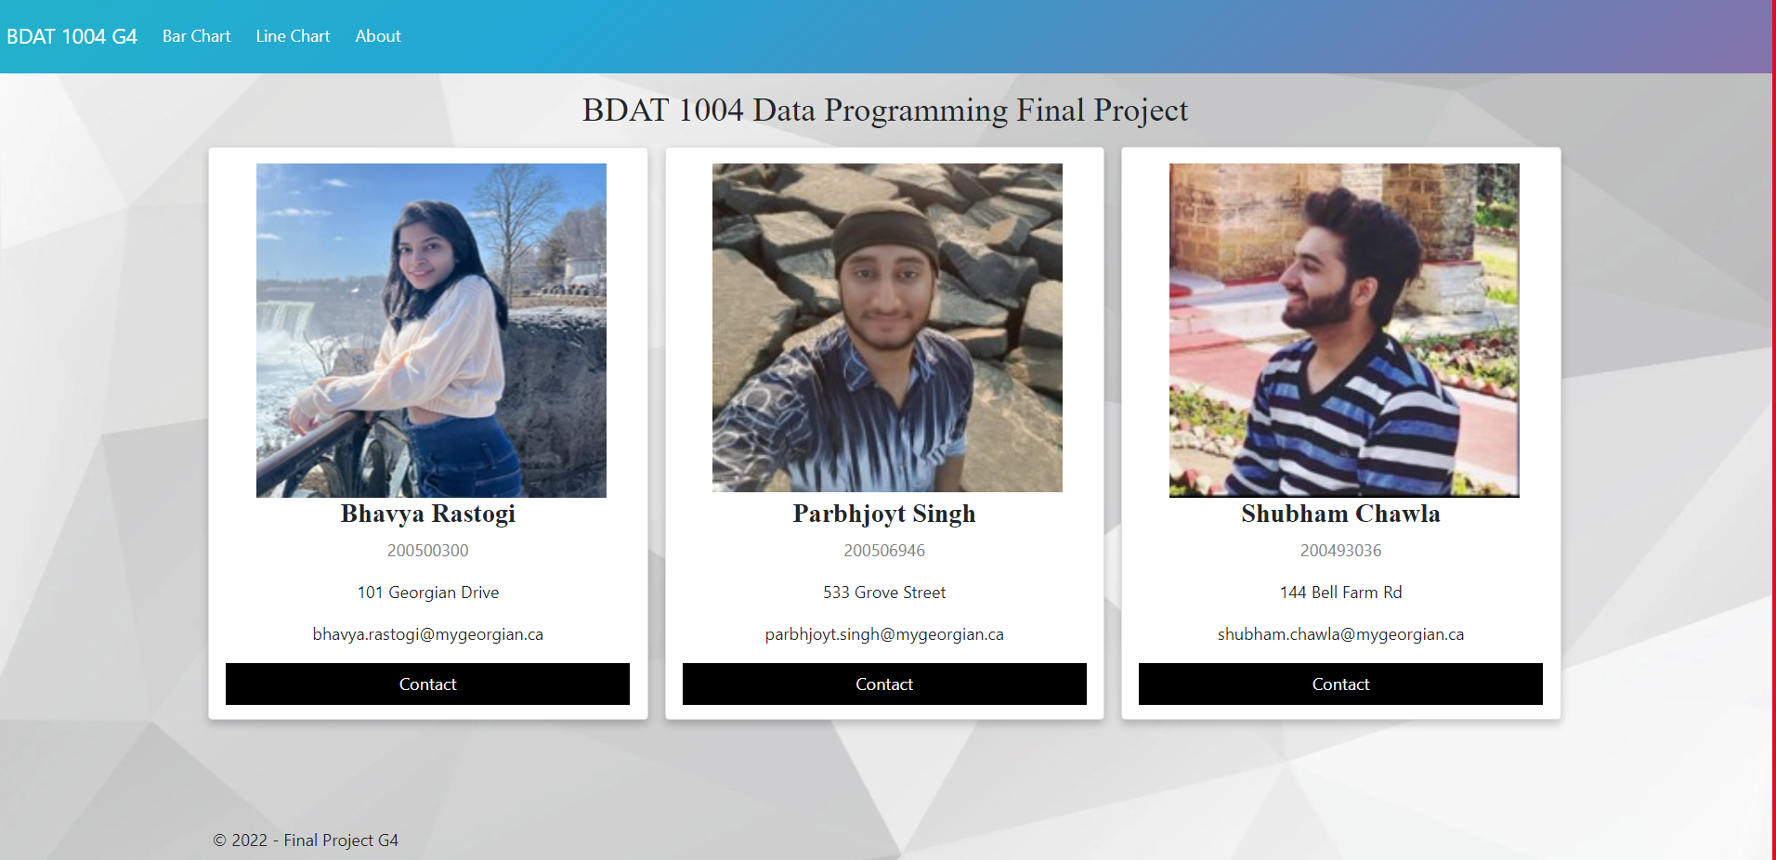
Website Design – About

Slide 23
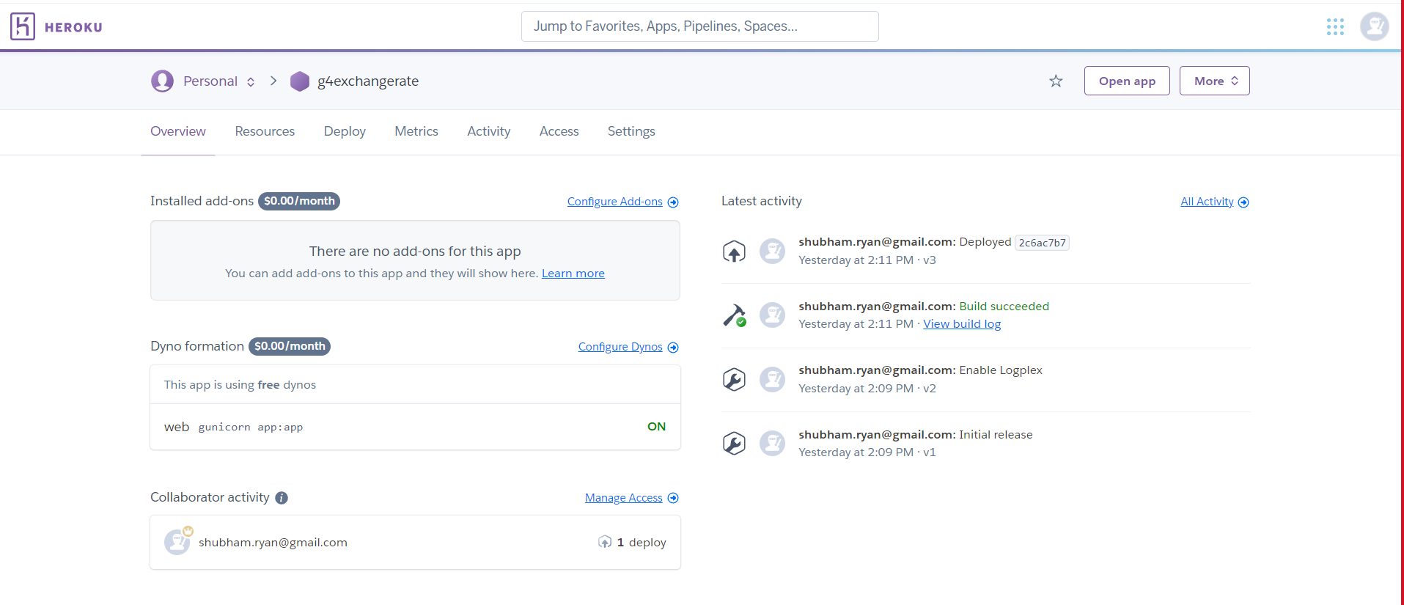
Website Deployment – Heroku – g4exchangerate

Slide 24
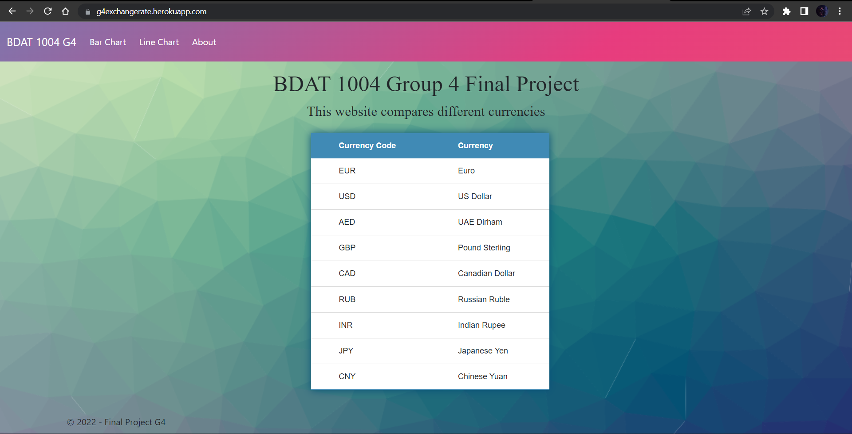
Website Deployment – Heroku – g4exchangerate

Slide 25

Fit – Gap Analysis (1)
More Data = Wider Purview
Adding more data to analysis can also help gain a broader and more complete perspective on a
business problem.
More visualizations could be created to analyze the changes in currency trend such as stacked bar charts, scatter plots etc.
More Javascript chart libraries could be integrated for having much more variety and customizations in the visualizations. For e.g., plotly.js, highcharts etc.
Adding interactive Filters for the User to analyze currency exchange trends according to their needs. For e.g., Filter for Date Range, Currency Code etc.

Slide 26
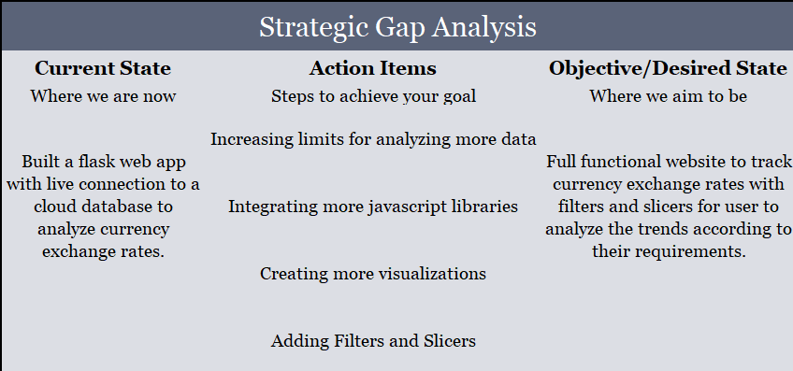
Fit – Gap Analysis (2)

Slide 27


Bonus Questions
Used MongoDB Realm to build an API that serves data
from a live cloud database - MongoDB
Used Postman to test the API using POST HTTP request with
a secret key parameter to answer the questions

Slide 28
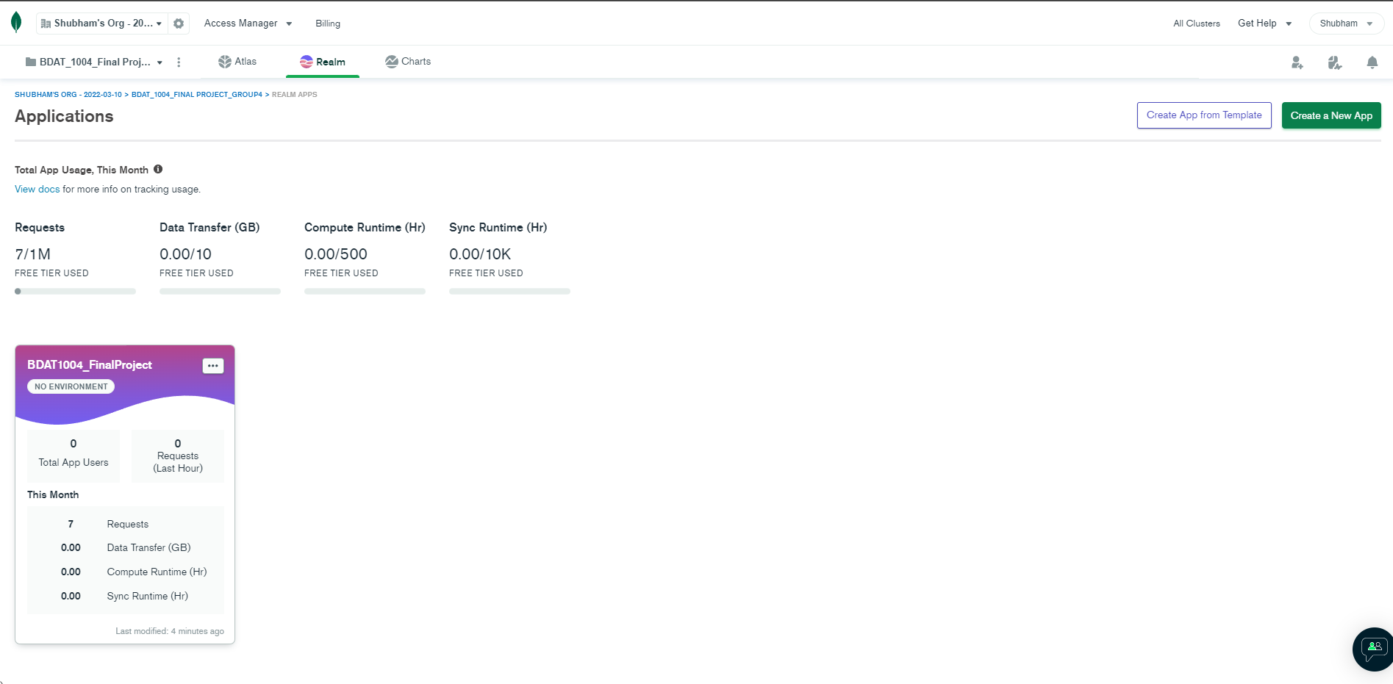
MongoDB Realm – Application Dashboard

Slide 29
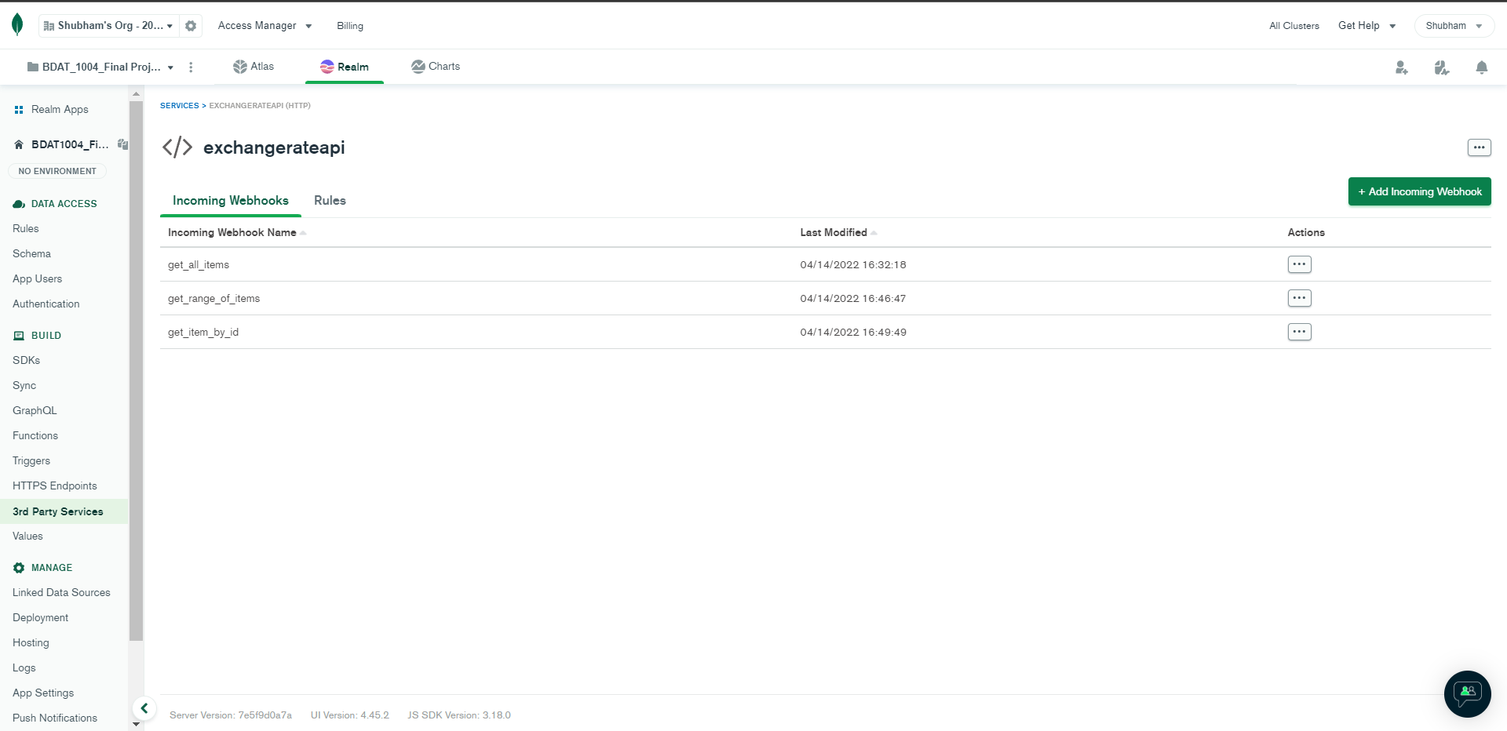
MongoDB Realm – exchangerateapi with 3 incoming webhooks

Slide 30
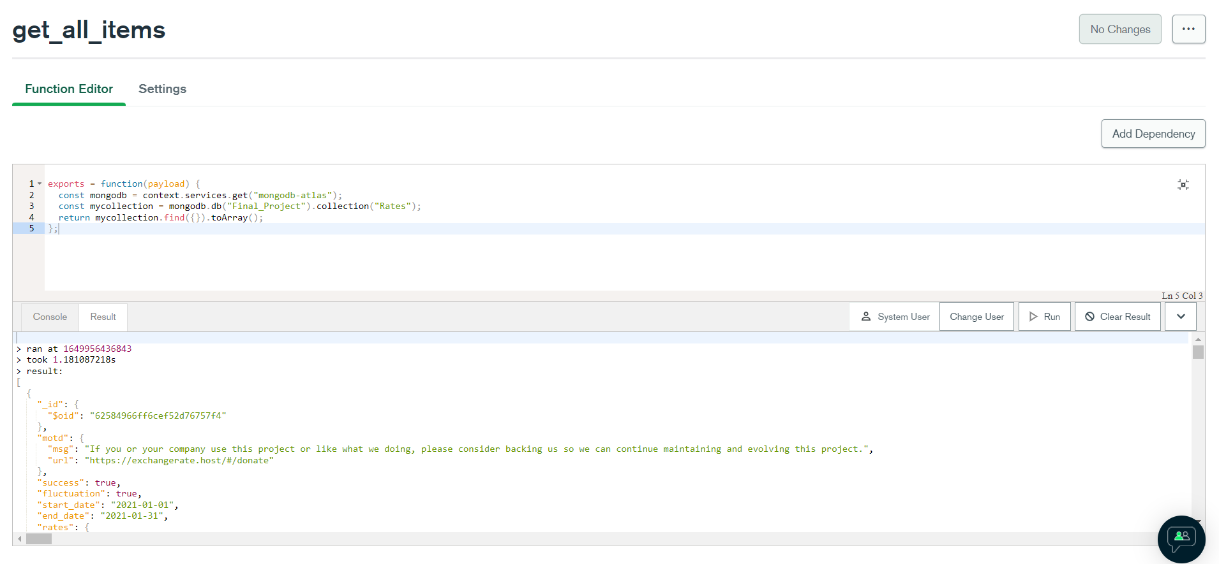
Webhook 1 – get_all_items
https://us-east-1.aws.webhooks.mongodb-realm.com/api/client/v2.0/app/bdat1004_finalproject-dnttk/service/exchangerateapi/incoming_webhook/get_all_items

Slide 31

Webhook 2 – get_range_of_items
https://us-east-1.aws.webhooks.mongodb-realm.com/api/client/v2.0/app/bdat1004_finalproject-dnttk/service/exchangerateapi/incoming_webhook/get_range_of_items

Slide 32

Webhook 3 – get_item_by_id
https://us-east-1.aws.webhooks.mongodb-realm.com/api/client/v2.0/app/bdat1004_finalproject-dnttk/service/exchangerateapi/incoming_webhook/get_item_by_id

Slide 33
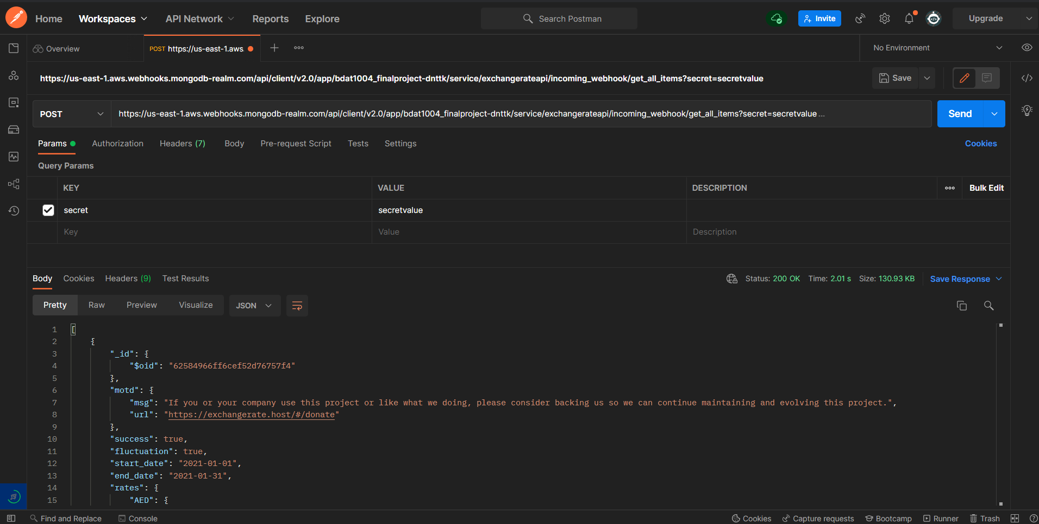
Postman – POST request for testing the API

Slide 34
Thank You

